Slide 1



Daily sales (beta)
View in Power BI
Last data refresh:
06/10/2026 17:11:30 UTC
Downloaded at:
06/10/2026 17:17:17 UTC

Slide 2
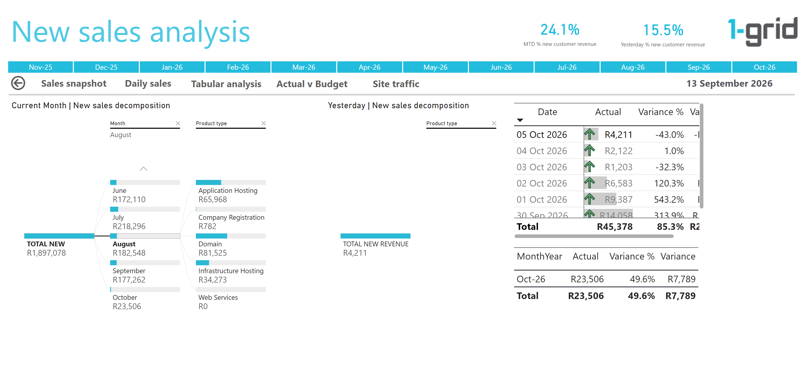
Daily
Notes:
Yesterday | New sales decomposition
No alt text provided
basicShape
No alt text provided
actionButton
No alt text provided
Sales Analysis
No alt text provided
image
No alt text provided
actionButton
No alt text provided
enlightenSlicerB18DC0CE4A1F4BA79CE49FBE40F3965F
No alt text provided
actionButton
No alt text provided
actionButton
No alt text provided
actionButton
No alt text provided
actionButton
No alt text provided
card
No alt text provided
tableEx
No alt text provided
tableEx
No alt text provided
card
No alt text provided
card
No alt text provided
Current Month | New sales decomposition
No alt text provided

Slide 3
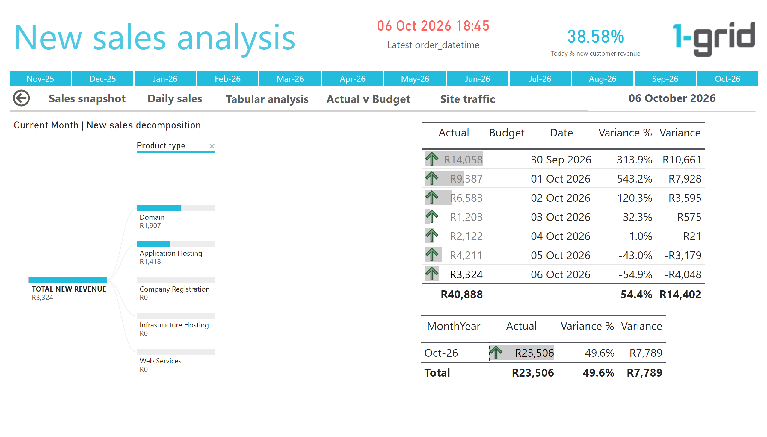
Midday view
Notes:
actionButton
No alt text provided
actionButton
No alt text provided
actionButton
No alt text provided
actionButton
No alt text provided
basicShape
No alt text provided
actionButton
No alt text provided
Sales Analysis
No alt text provided
image
No alt text provided
actionButton
No alt text provided
enlightenSlicerB18DC0CE4A1F4BA79CE49FBE40F3965F
No alt text provided
card
No alt text provided
tableEx
No alt text provided
tableEx
No alt text provided
card
No alt text provided
Current Month | New sales decomposition
No alt text provided
card
No alt text provided

Slide 4
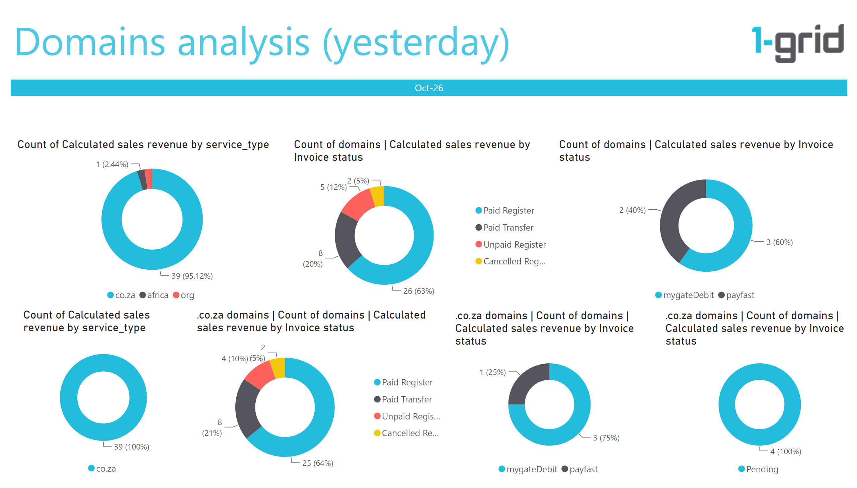
Domains
Notes:
.co.za domains | Count of domains | Calculated sales revenue by Invoice status
No alt text provided
donutChart
No alt text provided
.co.za domains | Count of domains | Calculated sales revenue by Invoice status
No alt text provided
Count of domains | Calculated sales revenue by Invoice status
No alt text provided
Count of domains | Calculated sales revenue by Invoice status
No alt text provided
donutChart
No alt text provided
Sales Analysis
No alt text provided
image
No alt text provided
enlightenSlicerB18DC0CE4A1F4BA79CE49FBE40F3965F
No alt text provided
.co.za domains | Count of domains | Calculated sales revenue by Invoice status
No alt text provided

Slide 5
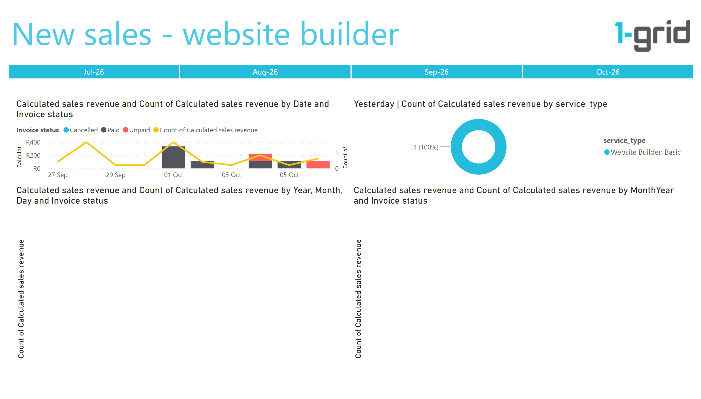
Web builder
Notes:
lineStackedColumnComboChart
No alt text provided
lineStackedColumnComboChart
No alt text provided
lineStackedColumnComboChart
No alt text provided
Sales Analysis
No alt text provided
image
No alt text provided
enlightenSlicerB18DC0CE4A1F4BA79CE49FBE40F3965F
No alt text provided
Yesterday | Count of Calculated sales revenue by service_type
No alt text provided

Slide 6
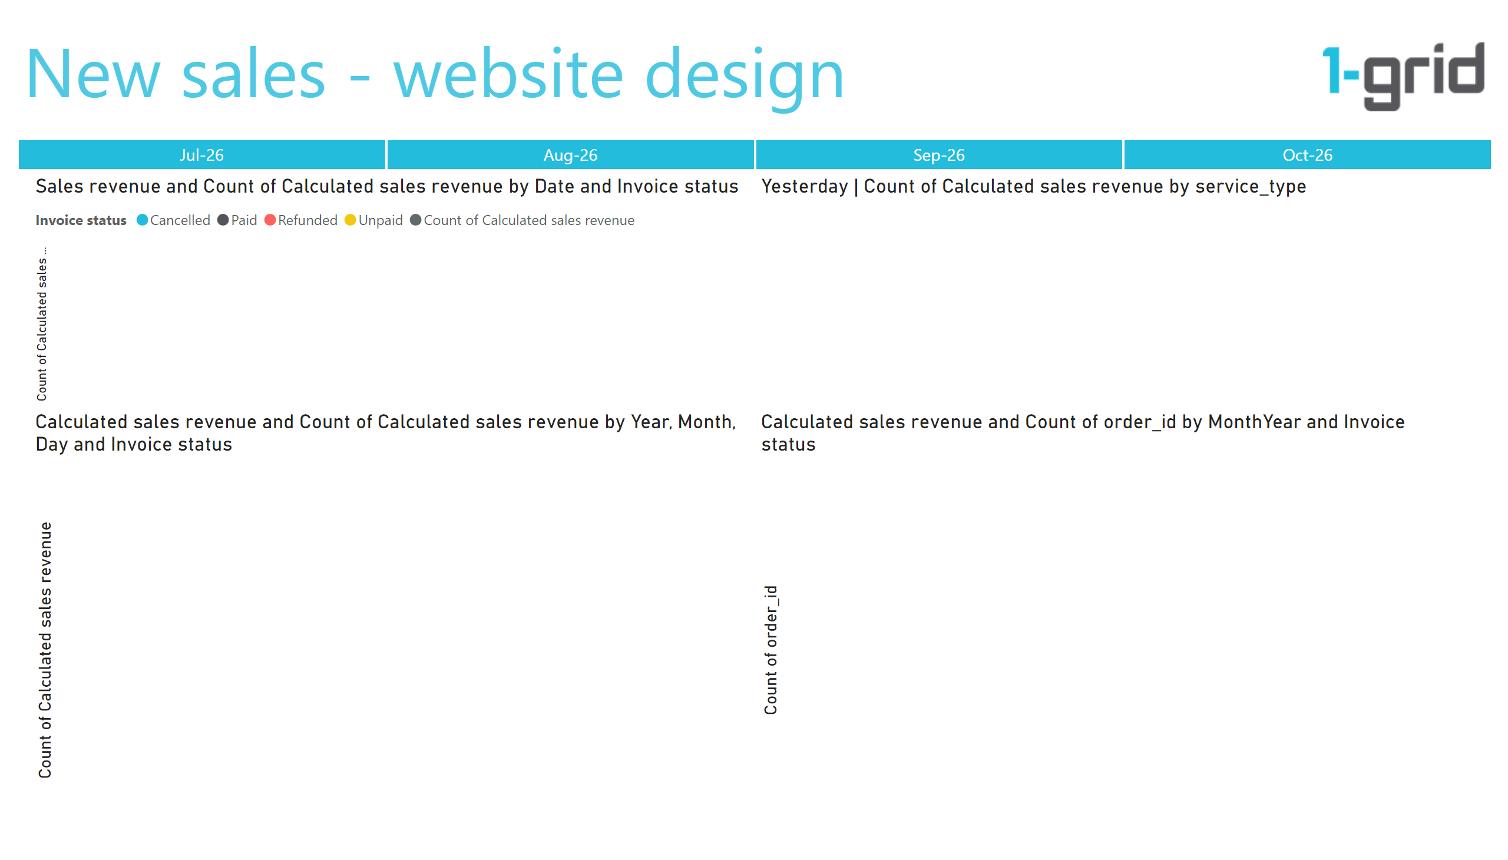
Web design
Notes:
lineStackedColumnComboChart
No alt text provided
lineStackedColumnComboChart
No alt text provided
lineStackedColumnComboChart
No alt text provided
Sales Analysis
No alt text provided
image
No alt text provided
enlightenSlicerB18DC0CE4A1F4BA79CE49FBE40F3965F
No alt text provided
Yesterday | Count of Calculated sales revenue by service_type
No alt text provided

Slide 7
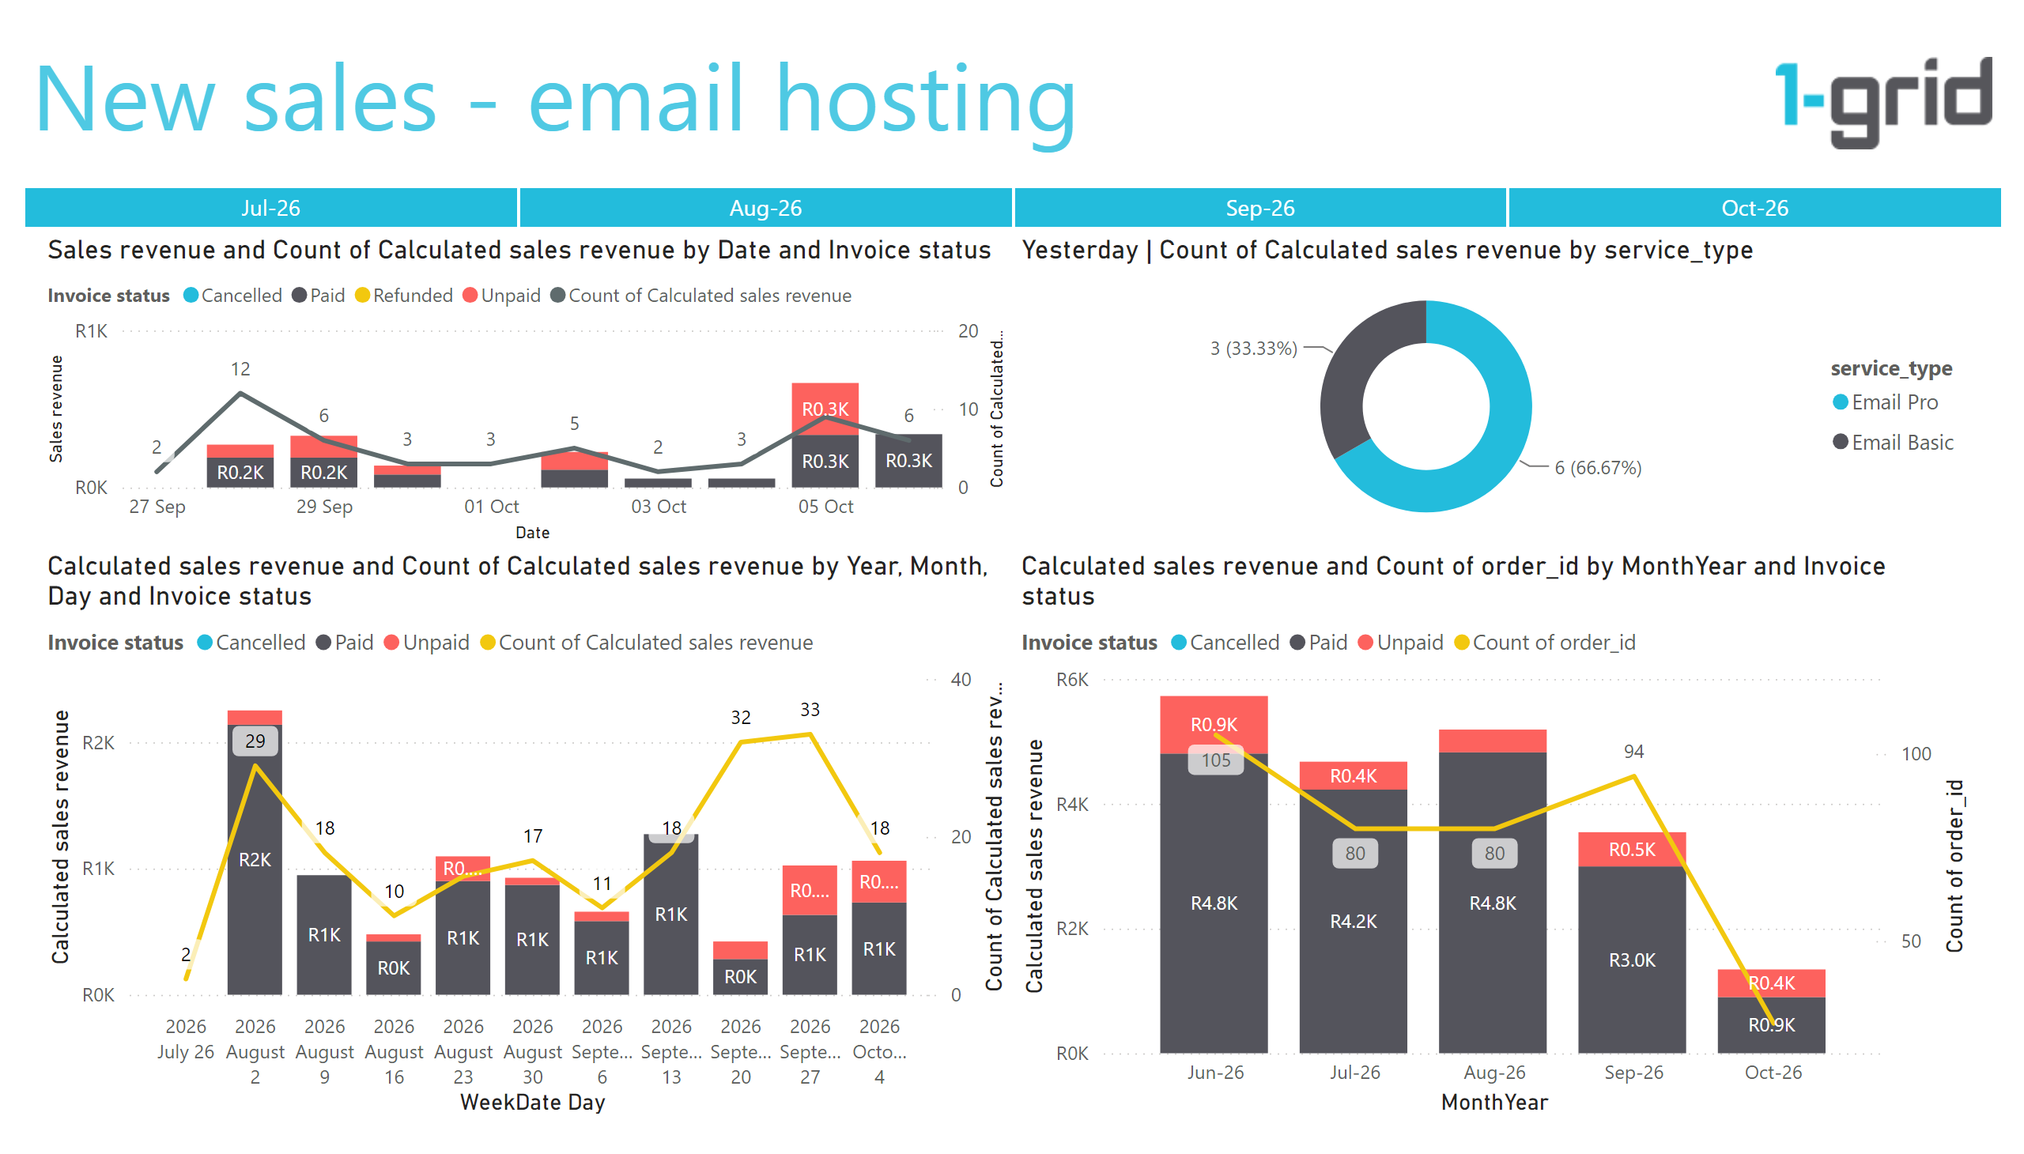
Email hosting
Notes:
lineStackedColumnComboChart
No alt text provided
lineStackedColumnComboChart
No alt text provided
lineStackedColumnComboChart
No alt text provided
Sales Analysis
No alt text provided
image
No alt text provided
enlightenSlicerB18DC0CE4A1F4BA79CE49FBE40F3965F
No alt text provided
Yesterday | Count of Calculated sales revenue by service_type
No alt text provided

Slide 8
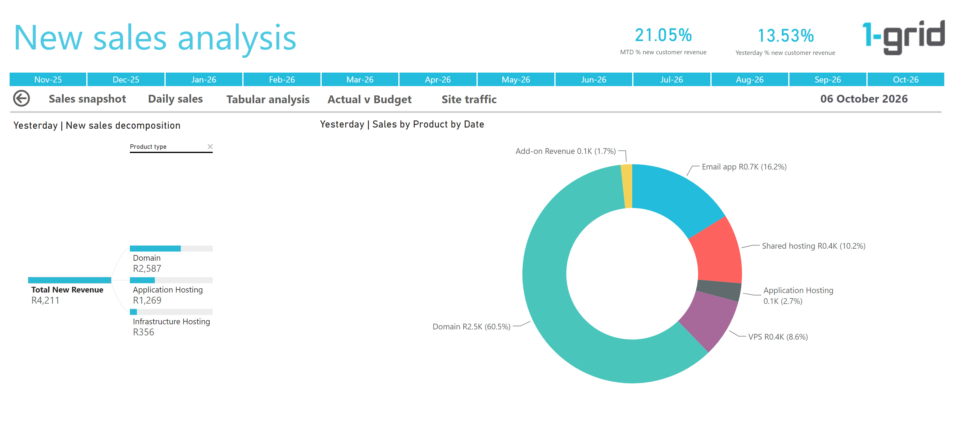
Daily by Product
Notes:
Yesterday | Sales by Product by Date
No alt text provided
Yesterday | New sales decomposition
No alt text provided
basicShape
No alt text provided
actionButton
No alt text provided
Sales Analysis
No alt text provided
image
No alt text provided
actionButton
No alt text provided
enlightenSlicerB18DC0CE4A1F4BA79CE49FBE40F3965F
No alt text provided
actionButton
No alt text provided
actionButton
No alt text provided
actionButton
No alt text provided
actionButton
No alt text provided
card
No alt text provided
card
No alt text provided
card
No alt text provided

Slide 9
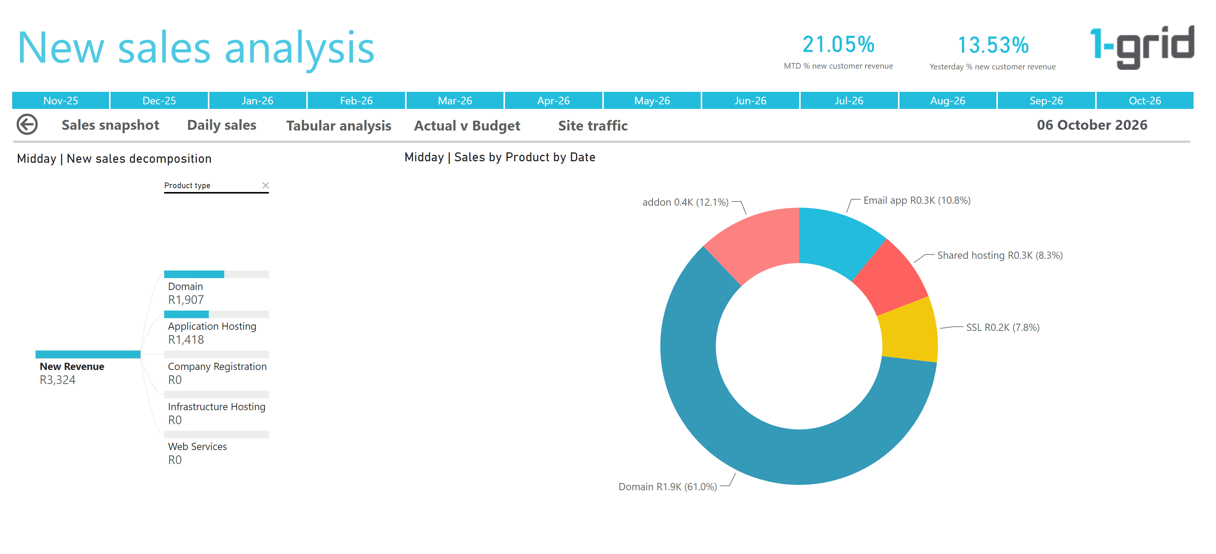
Midday Daily by Product
Notes:
card
No alt text provided
card
No alt text provided
enlightenSlicerB18DC0CE4A1F4BA79CE49FBE40F3965F
No alt text provided
card
No alt text provided
actionButton
No alt text provided
image
No alt text provided
actionButton
No alt text provided
actionButton
No alt text provided
actionButton
No alt text provided
actionButton
No alt text provided
Sales Analysis
No alt text provided
actionButton
No alt text provided
basicShape
No alt text provided
Midday | New sales decomposition
No alt text provided
Midday | Sales by Product by Date
No alt text provided

